Slide 1

Valuation of
——with DCF and Relative Valuation
January 11, 2024
Group 6: Zesong Wu, Yelan Yao, Jiachen Li, Jie Yao, Yuhang Qin, Pengye Shi

Slide 2
Contents
1
Introduction to GAMBOL
2
Absolute Valuation(DCF)
3
Relative Valuation
4
Extensions

Slide 3
Contents
1
Introduction to GAMBOL
2
Absolute Valuation(DCF)
3
Relative Valuation
4
Extensions

Slide 4



Introduction to GAMBOL
Gambol Pet Group, established in 2006.
From 2006 to 2012, primarily focused on exporting chicken jerky and other pet snacks.
Actively transitioned to domestic independent brands from 2013 to 2016.
Since 2017, the company has experienced rapid growth and has become a leading enterprise in China's pet food industry.
2006-2012
2013-2016
2017 - Now
1
Initial founding period
2
Transitional period
3
Rapid development period

Slide 5
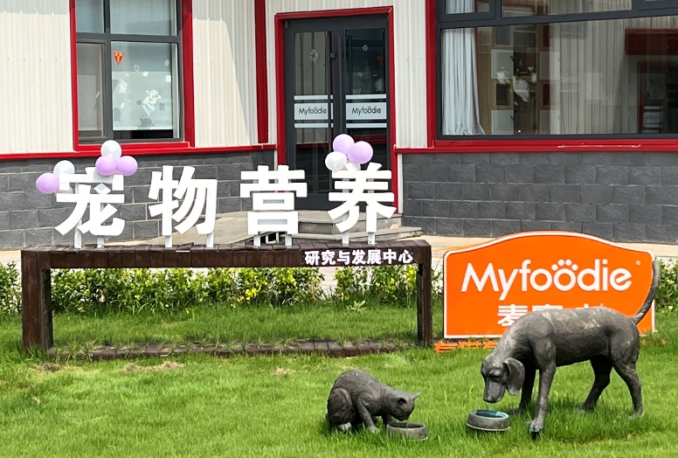
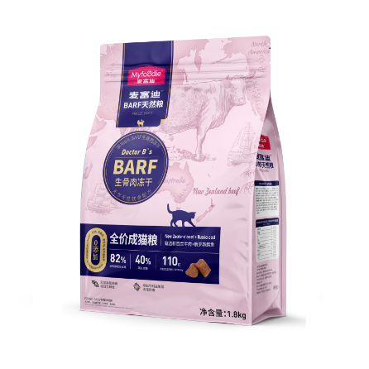
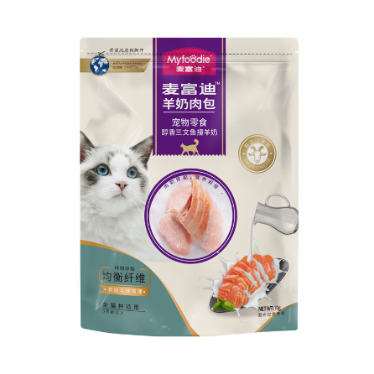
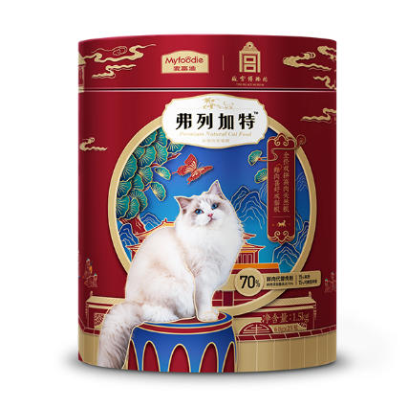

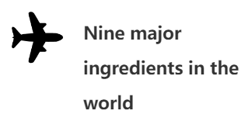













Introduction to GAMBOL
Multi-category products
Multiple sales channels
Well-developed R&D system
High brand recognition

Slide 6
Introduction to GAMBOL
Total Revenue and YOY
Net Profit Attributable to Shareholders of the Parent Company and YOY
Operating Revenue of each operation
Percentage of each operation

Slide 7
Background of The Deal
Items | Information
Name of the IPO Firm | Gambol Pet Group Ltd
Method of IPO | The Offering will ultimately be made through a combination of offline placement to qualified investors and online pricing to public investors holding unrestricted A shares and unrestricted depositary receipts with market capitalization in the Shenzhen market.
Date of IPO | 2023/8/16
Size of IPO | The issuance size was 40.0045 million shares, the price per share was ￥39.99. A total of ￥1599.78 million was raised.
IPO P/E Ratio | 61.28 times
Opening Price | ￥60 per share

Slide 8
Industry overview
Enlightenment period (1990s-1999)
Growth period (2000-2014)
Rapid development period (2015 to present)
Along with the development of the Internet, the first online pet service platforms emerged
The concept of "pet companion" is on the rise in China.
China's pet industry has entered a stage of rapid development
Growing national economy drives rapid development of pet market
Rise of local brands in the domestic market
Domestic pet rejuvenation, young people become the main force of consumption
Domestic industry concentration increases, favoring headline companies

Slide 9
Contents
1
Introduction to GAMBOL
2
Absolute Valuation(DCF)
3
Relative Valuation
4
Extensions

Slide 10
Net Income & Two Stages Model
Calculation of Net Income
 | Sales
- | Cost of goods sold
- | Selling, general, and administrative expenses
- | Depreciation
- | Interest expenses
- | Taxes
= | Net Income
Net income = (Sales - COGS - SG&A - Depreciation - Interest) * (1 -τ)

Slide 11
Revenue Forecast
Sales Revenue Forecast
(Million Yuan) | 2019 | 2020 | 2021 | 2022 | 2023E | 2024E | 2025E | 2026E | 2027E
Revenue | 1403.14 | 2013.04 | 2575.16 | 3397.54 | 4202.29 | 5061.06 | 6075.06 | 7178.52 | 8318.26
Snacks | 909.02 | 1296.16 | 1629.93 | 1954.02 | 2247.12 | 2516.78 | 2768.46 | 3045.30 | 3349.83
Staple Food | 483.49 | 695.51 | 912.01 | 1388.44 | 1874.39 | 2436.71 | 3167.72 | 3959.65 | 4751.58
Health Care Products | 7.59 | 12.95 | 18.14 | 36.70 | 58.72 | 82.20 | 110.97 | 144.26 | 187.54
Others | 3.05 | 8.42 | 15.09 | 18.38 | 22.06 | 25.37 | 27.90 | 29.30 | 29.30
Revenue Growth Rate
 | 2019 | 2020 | 2021 | 2022 | 2023E | 2024E | 2025E | 2026E | 2027E
Revenue Growth Rate |  | 43.47% | 27.92% | 31.93% | 23.69% | 20.44% | 20.04% | 12.04% | 12.04%
Snacks |  | 42.59% | 25.75% | 19.88% | 15.00% | 12.00% | 10.00% | 10.00% | 10.00%
Staple Food |  | 43.85% | 31.13% | 52.24% | 35.00% | 30.00% | 30.00% | 25.00% | 20.00%
Health Care Products |  | 70.63% | 40.07% | 102.34% | 60.00% | 40.00% | 35.00% | 30.00% | 30.00%
Others |  | 175.99% | 79.12% | 21.85% | 20.00% | 15.00% | 10.00% | 5.00% | 0.00%

Slide 12
COGS Forecast
Cost of Good Sold Forecast
(Million Yuan) | 2019 | 2020 | 2021 | 2022 | 2023E | 2024E | 2025E | 2026E | 2027E
COGS | 997.93 | 1345.67 | 1730.58 | 2135.24 | 2738.76 | 3276.95 | 3905.27 | 4707.44 | 5436.84
Snacks | 717.85 | 929.96 | 1,143.05 | 1,299.32 | 1,572.99 | 1,761.75 | 1,937.92 | 2,131.71 | 2,344.88
Staple Food | 275.19 | 405.58 | 570.51 | 806.39 | 1,124.64 | 1,462.03 | 1,900.63 | 2,494.58 | 2,993.50
Health Care Products | 2.80 | 5.12 | 6.98 | 15.36 | 23.49 | 32.88 | 44.39 | 57.71 | 75.02
Others | 2.10 | 5.01 | 10.04 | 14.17 | 17.65 | 20.29 | 22.32 | 23.44 | 23.44

Slide 13
Gross Profit & Gross Margin Forecast
Gross Profit and Gross Margin Forecast
(Million Yuan) | 2019 | 2020 | 2021 | 2022 | 2023E | 2024E | 2025E | 2026E | 2027E
Gross Profit | 405.22 | 667.37 | 844.59 | 1,262.30 | 1,463.54 | 1,784.11 | 2,169.79 | 2,471.08 | 2,881.42
Gross Margin | 28.88% | 33.15% | 32.80% | 37.15% | 34.83% | 35.25% | 35.72% | 34.42% | 34.64%
Snacks | 191.17 | 366.20 | 486.88 | 654.70 | 674.14 | 755.03 | 830.54 | 913.59 | 1,004.95
 | 21.03% | 28.25% | 29.87% | 33.51% | 30.00% | 30.00% | 30.00% | 30.00% | 30.00%
Staple Food | 208.30 | 289.93 | 341.50 | 582.05 | 749.76 | 974.68 | 1,267.09 | 1,465.07 | 1,758.09
 | 43.08% | 41.69% | 37.44% | 41.92% | 40.00% | 40.00% | 40.00% | 37.00% | 37.00%
Health Care Products | 4.79 | 7.83 | 11.16 | 21.34 | 35.23 | 49.32 | 66.58 | 86.56 | 112.53
 | 63.17% | 60.47% | 61.52% | 58.15% | 60.00% | 60.00% | 60.00% | 60.00% | 60.00%
Others | 0.95 | 3.41 | 5.05 | 4.22 | 4.41 | 5.07 | 5.58 | 5.86 | 5.86
 | 31.27% | 40.49% | 33.47% | 22.93% | 20.00% | 20.00% | 20.00% | 20.00% | 20.00%

Slide 14
Income Statement Forecast
(Million Yuan) | 2018 | 2019 | 2020 | 2021 | 2022 | 2023E | 2024E | 2025E | 2026E | 2027E
Revenue | 1221.11 | 1403.14 | 2013.04 | 2575.16 | 3397.54 | 4202.29 | 5061.06 | 6075.06 | 6806.36 | 7625.70
COGS | (829.74) | (997.93) | (1422.24) | (1834.07) | (2290.37) | (2738.76) | (3276.95) | (3905.27) | (4463.39) | (4984.18)
Gross Profit | 391.37 | 405.22 | 590.80 | 741.09 | 1107.17 | 1463.54 | 1784.11 | 2169.79 | 2342.97 | 2641.52
Business Tax Expense | (7.85) | (7.24) | (12.41) | (10.89) | (15.21) | (18.91) | (22.77) | (27.34) | (30.63) | (34.32)
Selling Expense | (166.67) | (245.92) | (264.24) | (355.83) | (545.17) | (630.34) | (759.16) | (911.26) | (1020.95) | (1143.85)
Administration Expense | (99.45) | (102.20) | (112.36) | (128.09) | (176.82) | (222.72) | (263.18) | (315.90) | (347.12) | (381.29)
R&D Expense | (27.65) | (35.53) | (44.05) | (59.36) | (67.85) | (84.05) | (101.22) | (121.50) | (136.13) | (152.51)
Financial Expense | (14.03) | (7.48) | (33.53) | (15.66) | 44.08 | 18.01 | 2.78 | (6.81) | (15.55) | (18.52)
Interest Expense | 0.00 | 0.00 | 11.48 | 18.90 | 11.84 | 1.04 | (5.13) | (8.78) | (10.99) | (11.64)
Interest Income | 0.00 | 0.00 | 1.91 | 0.51 | 1.94 | 3.02 | 7.09 | 8.02 | 9.56 | 11.88
Exchange Gain or Loss | 0.00 | 0.00 | 15.56 | 6.36 | (23.83) | (15.00) | (20.00) | (20.00) | (15.00) | (15.00)
Others | 0.41 | 4.61 | 6.16 | 3.70 | 6.58 | 8.16 | 6.07 | 11.76 | 14.48 | 16.21
Operating Profit | 76.12 | 11.47 | 136.36 | 162.93 | 319.05 | 520.68 | 638.85 | 795.55 | 812.61 | 935.76
Nonbusiness Income | 0.46 | 0.52 | 0.50 | 17.70 | 0.46 | 0.50 | 0.50 | 0.50 | 0.50 | 0.50
Non-business Expenditure | (0.81) | (1.79) | (1.35) | (1.99) | (1.60) | (1.50) | (1.50) | (1.50) | (1.00) | (1.00)
Pretax Profit | 75.78 | 10.20 | 135.51 | 178.65 | 317.91 | 519.68 | 637.85 | 794.55 | 812.11 | 935.26
Tax Rate | 0.41 | 0.59 | 0.18 | 0.21 | 0.16 | 0.15 | 0.15 | 0.15 | 0.15 | 0.15
Income Tax | (31.26) | (6.04) | (24.03) | (36.84) | (52.26) | (77.95) | (95.68) | (119.18) | (121.82) | (140.29)
Profit After Tax | 44.52 | 4.16 | 111.48 | 141.81 | 265.65 | 441.73 | 542.17 | 675.37 | 690.30 | 794.97
Minority Interests | 0.00 | 0.00 | 0.00 | (1.51) | 0.96 | 0.70 | 0.45 | 0.55 | (0.30) | (0.50)
Net Income | 44.52 | 4.16 | 111.48 | 140.27 | 266.88 | 442.43 | 542.62 | 675.92 | 690.00 | 794.47

Slide 15
DCF Model
FCFF = NOPLAT+ non-cash expense - investment in operating working capital - capital expenditure
NOPLAT (Net Operating Profits Less Adjusted Taxes)
= Net profit + interest after tax = Net profit + interest (1- income tax rate)
(Million Yuan) | 2019 | 2020 | 2021 | 2022 | 2023E | 2024E | 2025E | 2026E | 2027E
NOPLAT | 7.98 | 136.00 | 156.55 | 263.12 | 439.56 | 552.87 | 687.63 | 701.38 | 806.32
Plus: non-cash operating expenses | 42.72 | 59.52 | 98.67 | 117.96 | 125.93 | 139.21 | 157.62 | 176.63 | 194.31
Less: Investment in operating working capital | 180.06 | 73.37 | 233.01 | 232.54 | 181.20 | 242.96 | 295.48 | 233.62 | 239.69
Less: Capital expenditure | 308.81 | 154.43 | 97.69 | 179.52 | 220.00 | 310.00 | 310.00 | 260.00 | 210.00
FCFF | (438.17) | (32.28) | (75.47) | (30.99) | 164.29 | 139.13 | 239.77 | 384.39 | 550.94
 | 2028E | 2029E | 2030E | 2031E | 2032E | 2033E | 2034E | 2035E
NOPLAT | 886.96 | 957.91 | 1034.54 | 1086.27 | 1140.59 | 1174.80 | 1210.05 | 1234.25
Plus: non-cash operating expenses | 293.59 | 317.08 | 342.44 | 359.57 | 377.54 | 388.87 | 400.54 | 408.55
Less: Investment in operating working capital | 434.87 | 214.74 | 231.92 | 156.55 | 164.37 | 103.56 | 106.66 | 73.24
Less: Capital expenditure | (325.20) | 67.11 | 72.47 | 48.92 | 51.37 | 32.36 | 33.33 | 22.89
FCFF | 1070.88 | 993.14 | 1072.59 | 1240.37 | 1302.39 | 1427.76 | 1470.59 | 1546.67
Notes:
investment in operating working capital

Slide 16

WACC and Enterprise Value
DCF Valuation | DCF(million)
Phase I | 1268.147827
Phase II | 6097.726355
Phase III | 19485.99552
Enterprise Value AEV | 26851.8697
Add: Non-operating net asset value | 1412.005
Less: Minority interest (market value) | 8.56
Less:Value of debt | 0
Total equity value | 28255.3147
Equity(millions of shares) | 400.0445
Value per share | 70.63042912
Risk-free rate | 1.5%
Beta | 1.02
Rm-Rf | 5.26%
Cost of equity | 0.06882
Tax rate | 15%
Effective tax rate | 0.15
Cost of debt*(1-t) | 0.04
D/E | 30%
WACC | 0.06017
Rf：One year fixed deposit interest rate (pre tax)
Beta：The arithmetic mean of the deleveraged original beta in the industry, then leverage and adjust tax rate
Rm：5 year average return of Shanghai and Shenzhen indices

Slide 17
Sensitivity Analysis
Sensitivity test result | Long-term Growth rate (g)
WACC | 0 | 0.50% | 1.00% | 1.50% | 2.00% | 2.50% | 3.00% | 3.50% | 4.00%
3.5% | 98.20 | 110.66 | 128.06 | 154.09 | 197.27 | 282.89 | 533.98 | 15153.21 | -524.92
4.0% | 84.79 | 93.66 | 105.48 | 121.98 | 146.67 | 187.62 | 268.83 | 506.96 | 14372.05
4.50% | 74.40 | 80.95 | 89.37 | 100.58 | 116.24 | 139.65 | 178.51 | 255.54 | 481.45
5.00% | 66.12 | 71.10 | 77.32 | 85.31 | 95.94 | 110.80 | 133.02 | 169.89 | 242.99
5.50% | 59.39 | 63.26 | 67.98 | 73.89 | 81.47 | 91.56 | 105.66 | 126.75 | 161.74
6.00% | 53.80 | 56.87 | 60.54 | 65.03 | 70.63 | 77.83 | 87.41 | 100.80 | 120.82
6.50% | 49.11 | 51.57 | 54.48 | 57.97 | 62.23 | 67.55 | 74.38 | 83.48 | 96.19
7.00% | 45.10 | 47.11 | 49.45 | 52.21 | 55.53 | 59.57 | 64.63 | 71.12 | 79.76
7.50% | 41.66 | 43.31 | 45.22 | 47.44 | 50.06 | 53.21 | 57.06 | 61.86 | 68.03
8.00% | 38.67 | 40.04 | 41.61 | 43.42 | 45.53 | 48.03 | 51.02 | 54.67 | 59.23
8.50% | 36.04 | 37.19 | 38.50 | 39.99 | 41.71 | 43.72 | 46.09 | 48.94 | 52.41

Slide 18
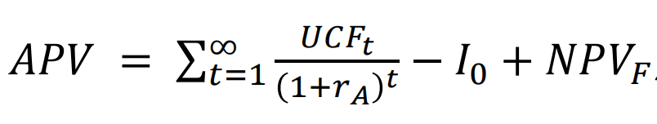
APV Model
Valuation
Risk-free rate | 1.5%
Rm-Rf | 5.26%
Beta(unlevered) | 0.75
Cost of Equity (unlevered) | 5.45%
Tax rate | 15%
The value of the company without debt | 1,412.01
Plus: The benefits of debt | 1,423.31
Less: Minority interests | 8.56
Total equity value | 31,335.45
Capital stock (millions of shares) | 400.04
Value per share (Yuan) | 78.33
The value of the company without debt
 | 2023E | 2024E | 2025E | 2026E | 2027E | 2028E | 2029E
FCFF | 164.286 | 139.127 | 239.772 | 384.394 | 550.944 | 1070.88 | 993.143
 | 2030E | 2031E | 2032E | 2033E | 2034E | 2035E
FCFF | 1072.59 | 1240.37 | 1302.39 | 1427.76 | 1470.59 | 1546.67

Slide 19
EVA Model
EVA = After-tax net operating profit - (WACC × Invested capital)
= NOPLAT-WACC ×IC
 | 2023E | 2024E | 2025E | 2026E
NOPLAT | 439.564 | 552.87 | 687.631 | 701.38
WACC | 0.06017 | 0.06017 | 0.06017 | 0.06017
IC | 2384.4 | 2795.43 | 3240.12 | 3554.79
EVA | 304.728 | 397.022 | 506.037 | 496.939
 | 2027E | 2028E | 2029E | 2030E
NOPLAT | 806.323 | 886.955 | 957.912 | 1034.54
WACC | 0.06017 | 0.06017 | 0.06017 | 0.06017
IC | 3807.59 | 5592.18 | 6039.55 | 6522.72
EVA | 584.809 | 604.141 | 607.944 | 656.579
 | 2031E | 2032E | 2033E | 2034E
NOPLAT | 1086.27 | 1140.59 | 1174.8 | 1210.05
WACC | 0.06017 | 0.06017 | 0.06017 | 0.06017
IC | 6848.85 | 7191.3 | 7407.04 | 7629.25
EVA | 683.957 | 718.154 | 735.578 | 757.645
 | 2035E
NOPLAT | 1234.25
WACC | 0.06017
IC | 7781.83
EVA | 770.569
EVA Evaluation | PV（million）
Phase I | 2010.355
Phase II | 3360.658
Phase III | 9708.18
Present value of operational economic added value | 15079.19
Plus: Invested capital | 2240.735
Plus: non-operating net asset value | 1412.005
Less: debt value | 0
Less: Minority interests | 8.56
Total equity value | 18723.37
Capital stock (millions of shares) | 400.0445
Value per share | 46.80323

Slide 20
Contents
1
Introduction to GAMBOL
2
Absolute Valuation(DCF)
3
Relative Valuation
4
Extensions

Slide 21


Comparable companies
 | Company | Stock Code | Company Core Business
1 | China Pet | 300673.SZ | The company is a global pet food diversified brand operator, mainly engaged in the research and development, production and sales of pet food for dogs and cats, the specific products cover two categories: snacks and staple food.
2 | Peidi | 002891.SZ | The company is currently the most large-scale and influential company in the field of pet leisure food in China, with the following main businesses: research and development of pet nutrition and other pet health products; production and sale of pet daily necessities; production and sale of pet food; import and export of goods, import and export of technology; and investment management.
As the Gambol Pet company is a mature company with more stable earnings and less cyclicality, we use PE method to value the company.
Company | Stock Code | Market Value (100 m) | Price | EPS |  |  |  | PE
 |  |  |  | 2022A | 2023E | 2024E | 2025E | 2022A | 2023E | 2024E | 2025E
China Pet | 300673.SZ | 75.91 | 25.81 | 0.36 | 0.72 | 0.9 | 1.11 | 61.95 | 35.89 | 28.65 | 23.17
Peidi | 002891.SZ | 34.52 | 13.62 | 0.5 | 0.18 | 0.52 | 0.69 | 35.19 | 76.88 | 26.3 | 19.65
min |  |  |  |  |  |  |  | 35.19 | 35.89 | 26.3 | 19.65
average |  |  |  |  |  |  |  | 48.57 | 56.385 | 27.475 | 21.41
max |  |  |  |  |  |  |  | 61.95 | 76.88 | 28.65 | 23.17
Gambol Pet | 301498.SZ | 164.90 | 41.22 | 0.74 | 0.98 | 1.22 | 1.54 | - | 42.23 | 33.76 | 26.73
Considering the current high proportion of the company's proprietary brand business and its trend towards product high-endization, coupled with the company's relative advantages in brand strength and production capacity, we assign a 60x PE ratio for the year 2024, corresponding to a target price of 58.8 yuan per share.
The company's closing price on 7 January 2024 was RMB 41.22 and our valuation result was RMB 58.8, indicating that the company's current share price is somewhat undervalued.
Source: Wind

Slide 22
Contents
1
Introduction to GAMBOL
2
Absolute Valuation(DCF)
3
Relative Valuation
4
Extensions

Slide 23
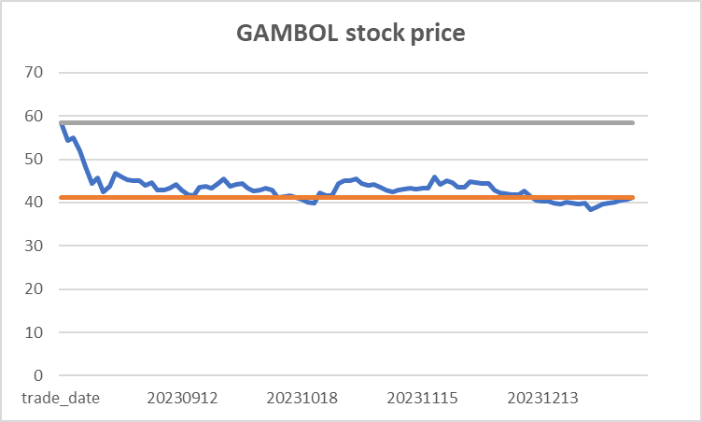
Extensions
Do you think the transaction price is fair?
Can you think of a trading strategy to profit from this deal?
￥58.45
Buy!
The stock price is severely undervalued
￥41.22
Why did this IPO happen? What was the motivation behind this event?
IPO
2023.8.16
With the further expansion of the company's scale, in order to seize market opportunities and enhance market competitiveness, it is still necessary to strengthen sales network construction and increase research and development investment
raise new capital

Slide 24
Extensions
What were the gains and losses of all possible parties related to the event?
parties | gain | loss
GAMBOL | raised ¥1.6 billion visibility and credibility | increased regulatory scrutiny Uncertainty
Investors | earn significant returns in short term | Uncertainty
Underwriters | earned ¥120 million | unable to sell certain shares
Employees | acquired some shares | Uncertainty
Did the management represent shareholders’ interest?
Not always.
raise funds for investment in some strategic projects such as intelligent warehousing
no history of dividends and clear dividend plans in the future
stock prices went down more than 30% since IPO.
Do you think this is a good or bad deal from the existing/new investors’ perspective?
Existing | good | Capital returns | New | good | opportunities to invest

Slide 25
Thank you!

